Slide 1

RPPOOP PROJECT PRESENTATION
Name: Pallavi Gaikwad
MIS: 142103005
Computer Department
Topic: Canteen Billing System

Slide 2

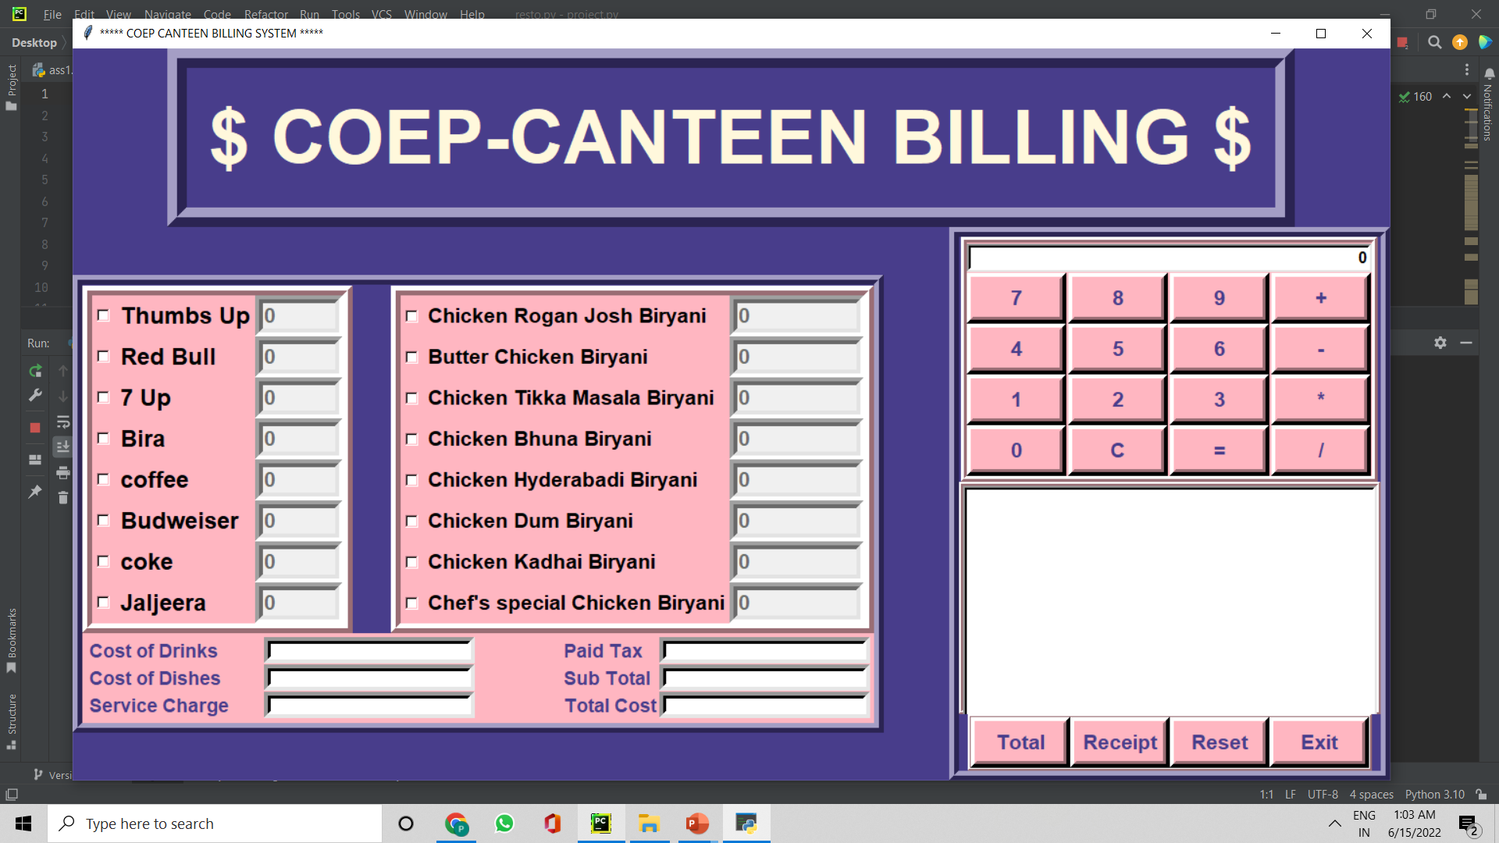
COEP CANTEEN BILLING SYSTEM !
The project is a system which calculates the bills of the canteen quickly and hassle free.
Problems: Manual Billing, Time Consuming ,Human Errors.
Solution: Our Project which is fast, bug free and easy to use!

Slide 3
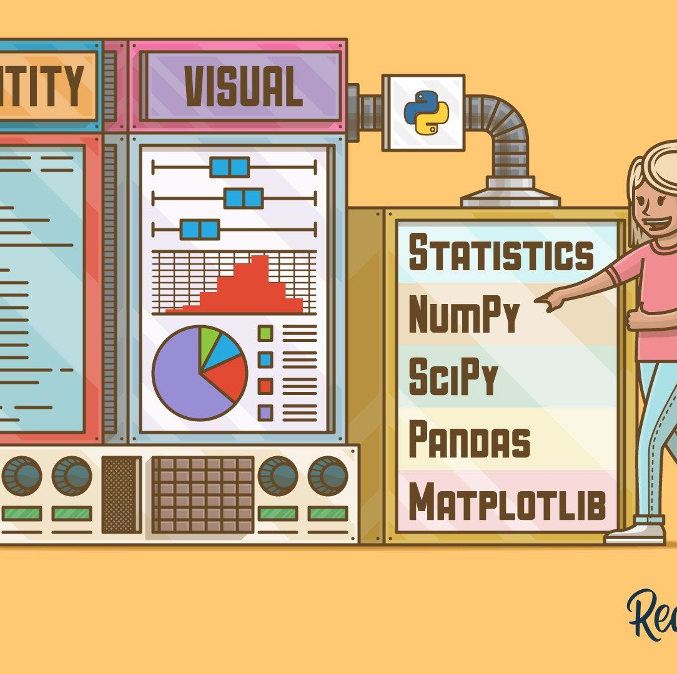
Modules & System Specifications:
Date Time Module
OS Module
Tkinter Module
Random Module
Python 3.9
Notepad
Any OS

Slide 4
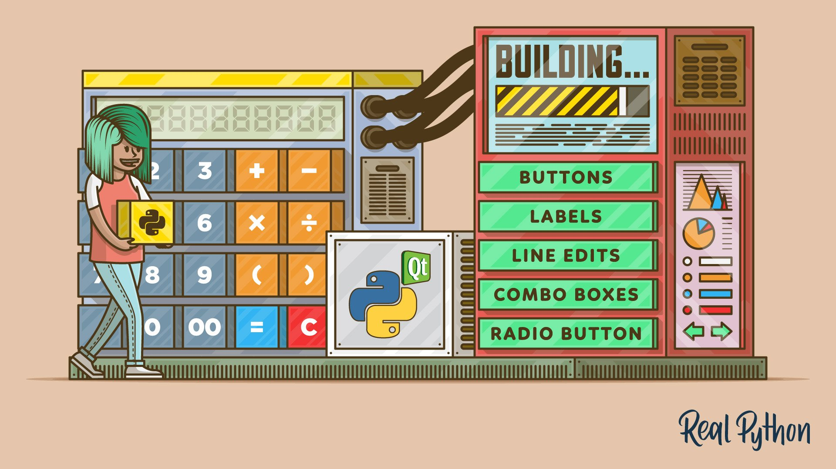
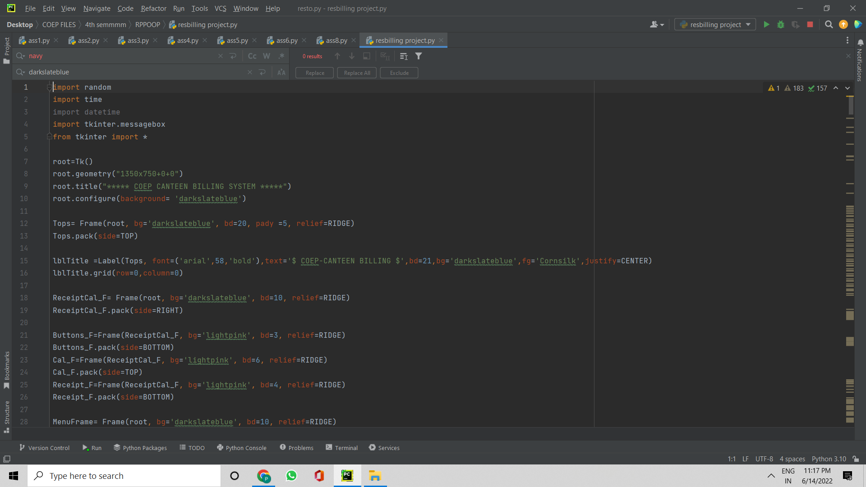
Main Parameters:
.
Parameters:
Title
Frame
Font
Font Size
Text
Background
Background color
Justify
Color

Slide 5
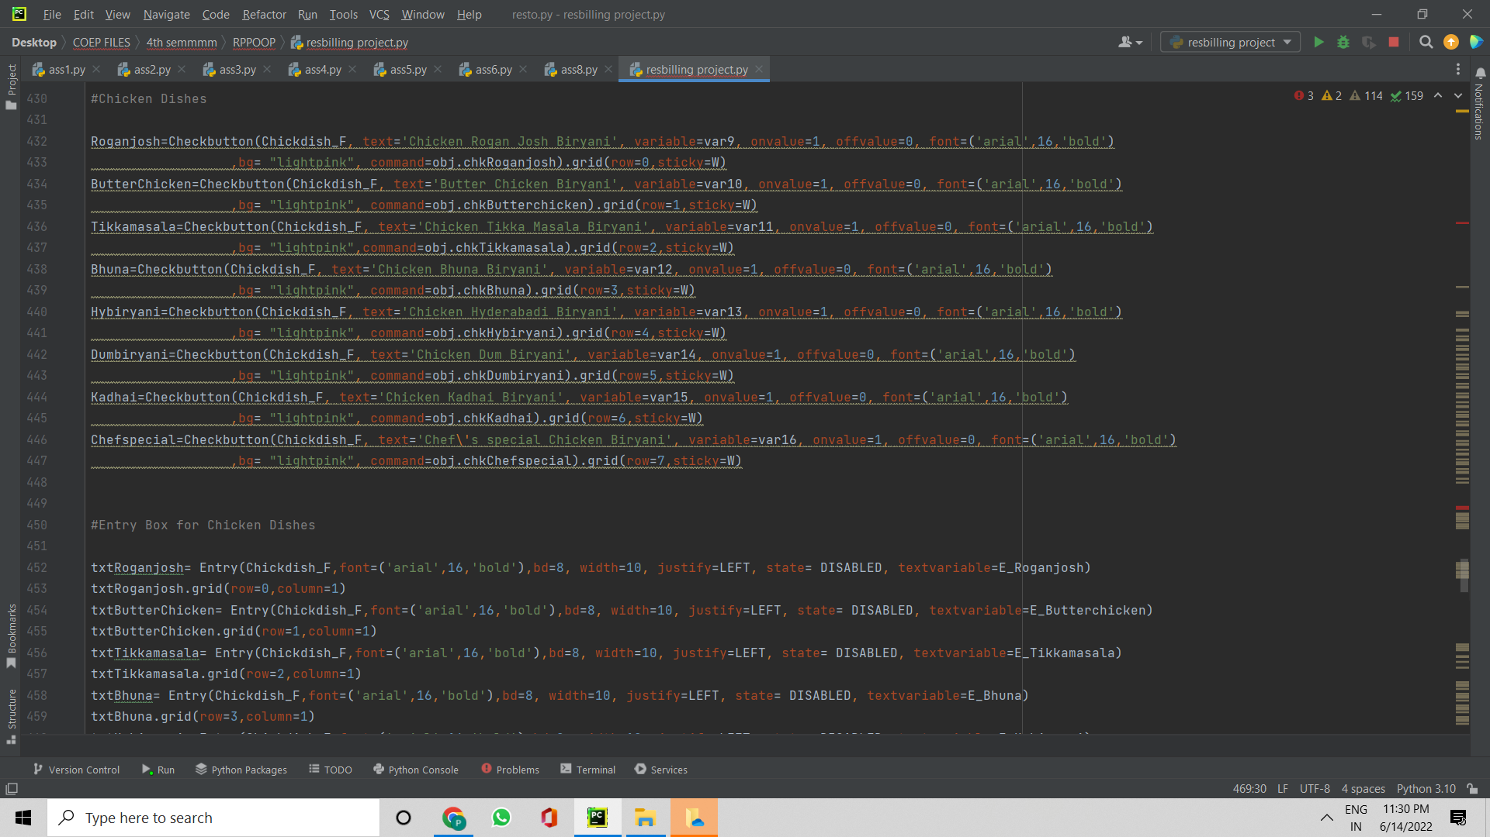

Parameters for dishes:

Slide 6

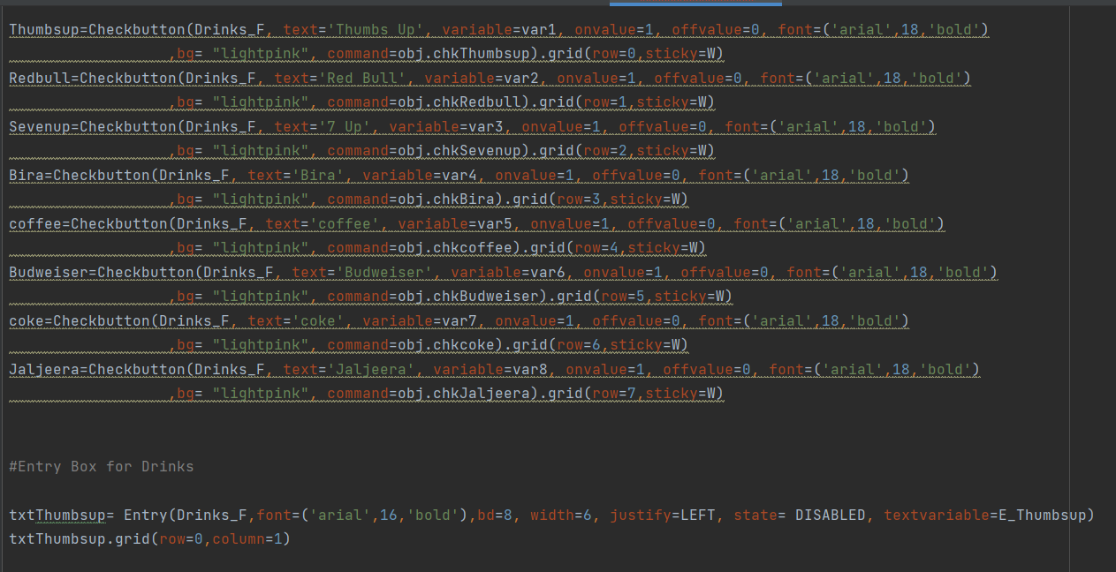
Parameters for drinks:

Slide 7

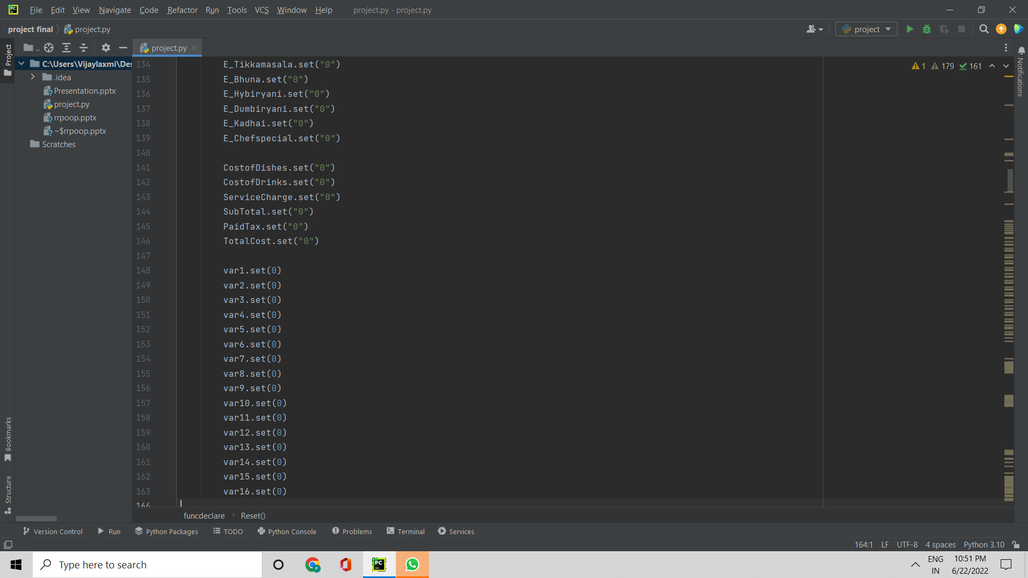
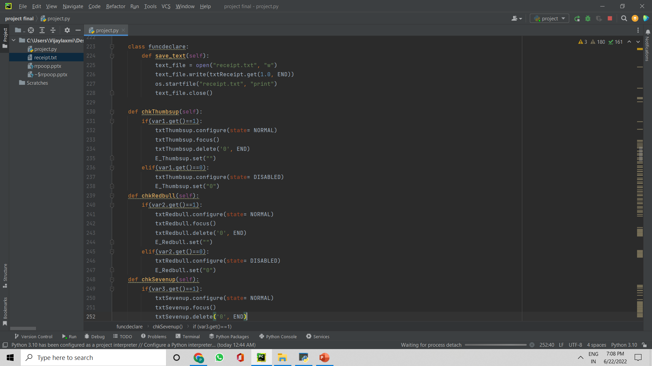
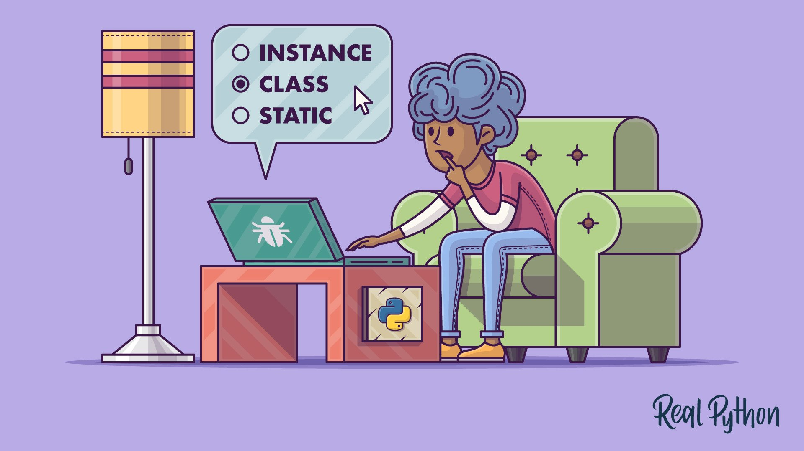
Class & Functions :

Slide 8
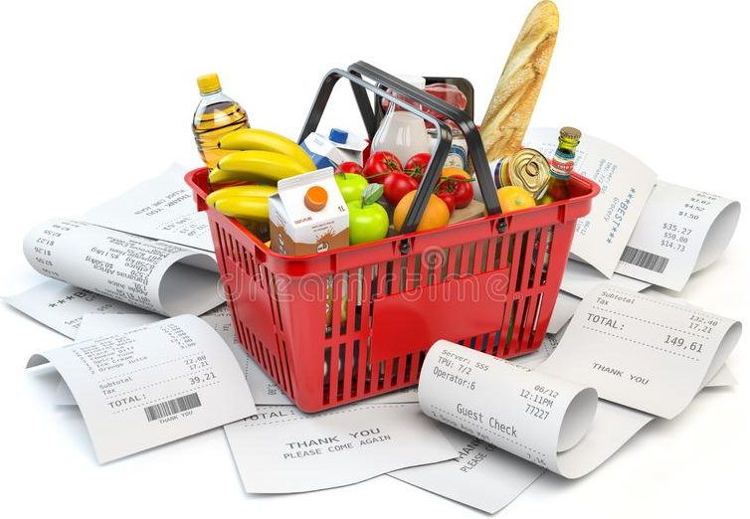
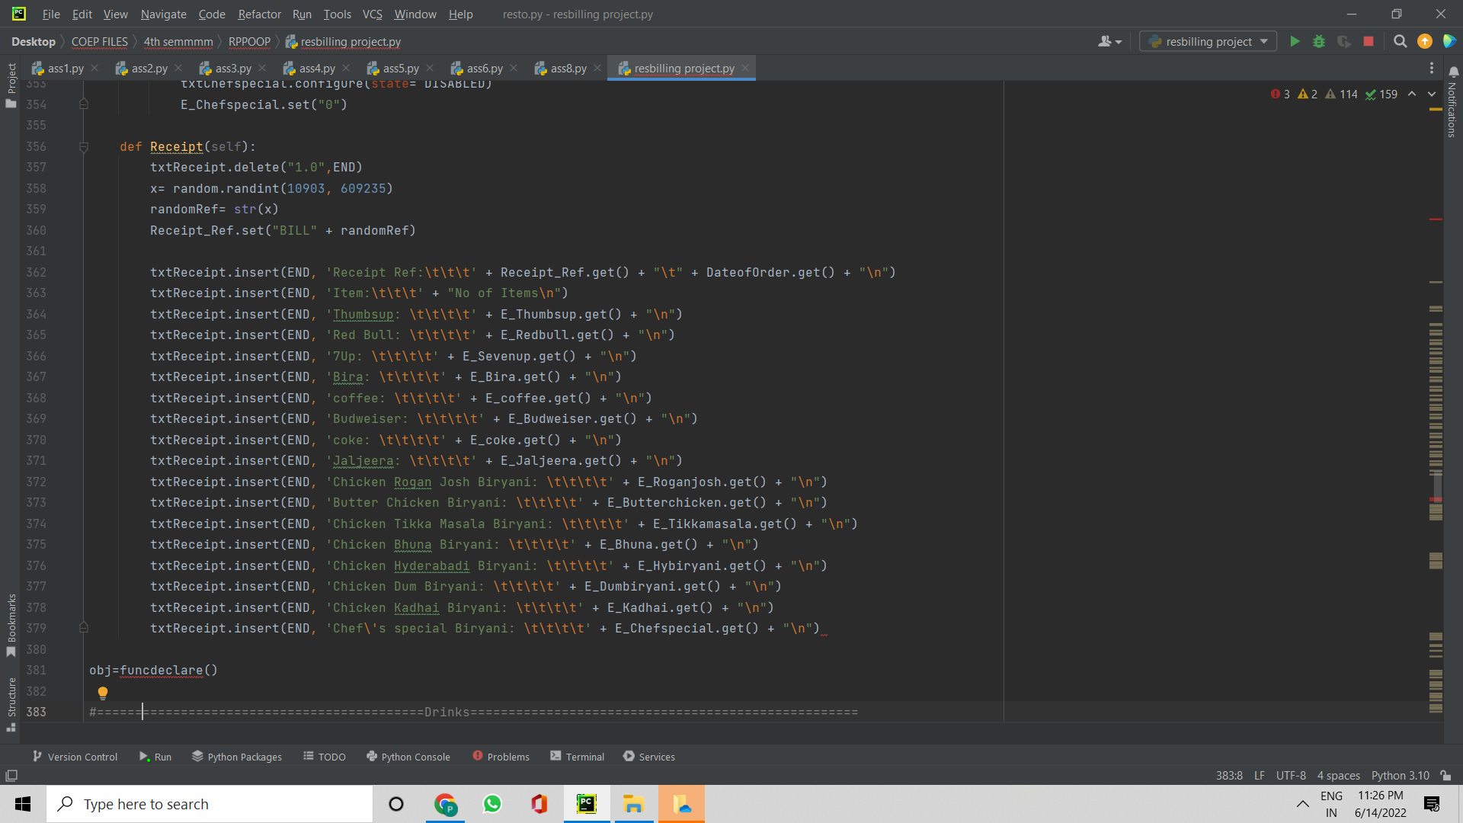
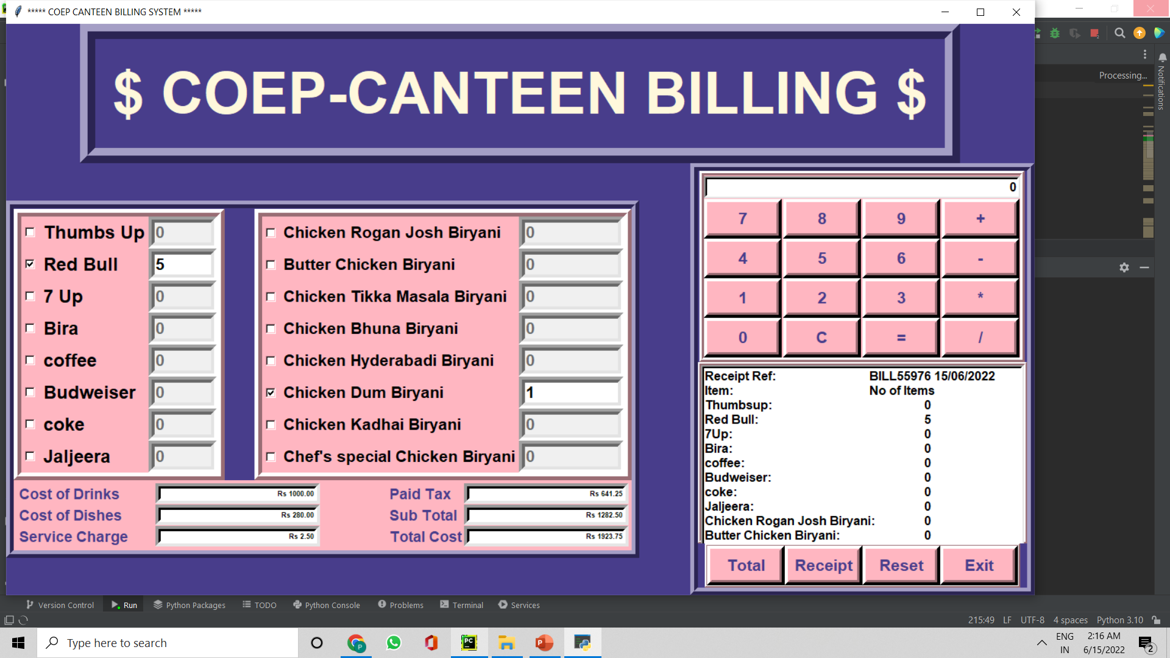
Receipt function:

Slide 9
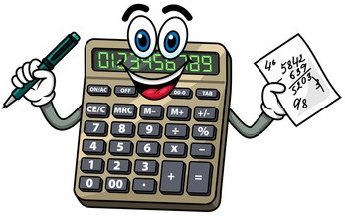
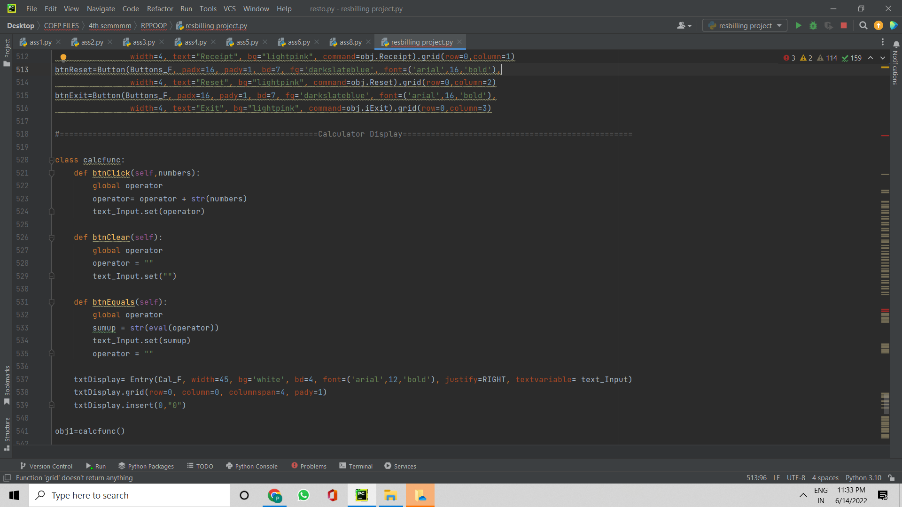
Calculator Function:

Slide 10
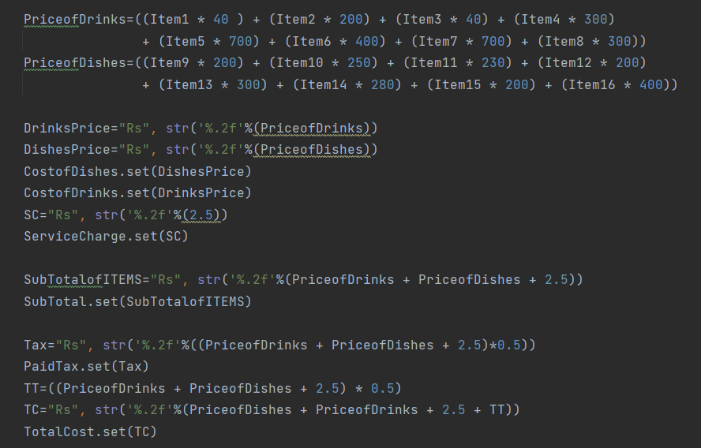


Costing & calculation of price Function:

Slide 11


Future Scope:
Project will be enhanced in terms of looks and appearance.
Instead of .txt file direct receipt printing can be done.
More food items can be added and the menu can also be displayed on the user interface.
Coupon discount feature can also be integrated in the system.

Slide 12

Come!! Let’s Have a look on how it works!!

